Slide 1
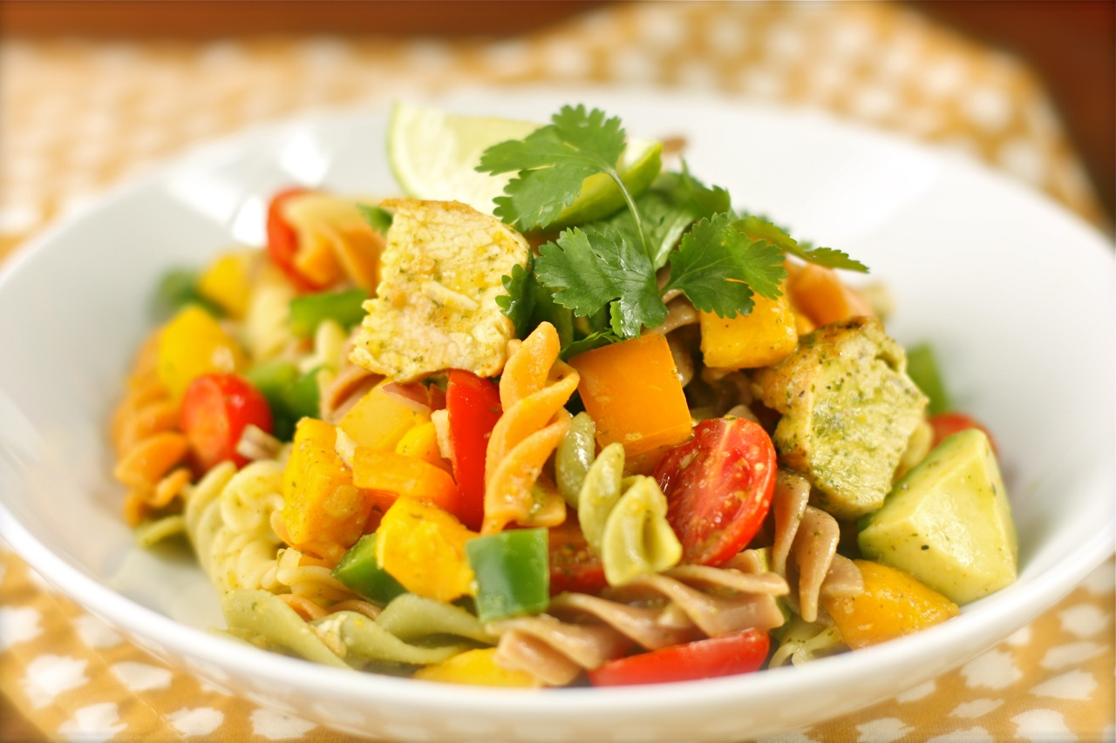
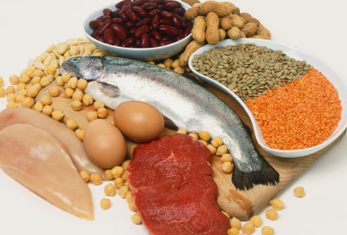
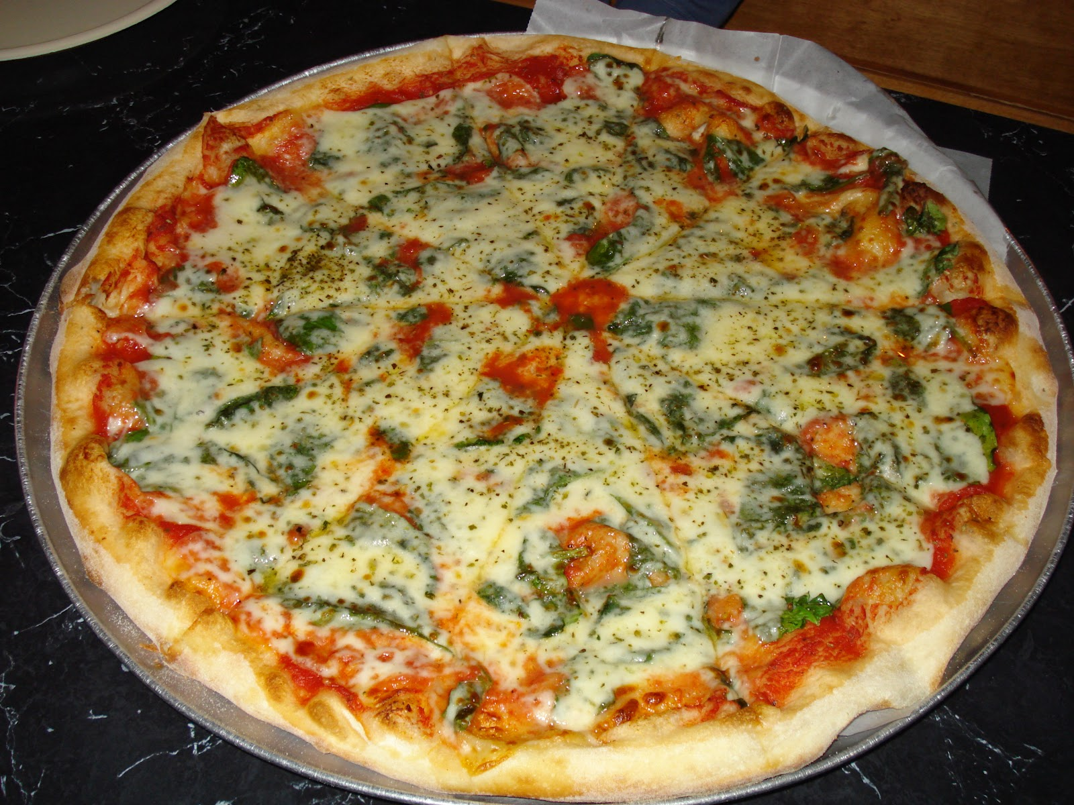
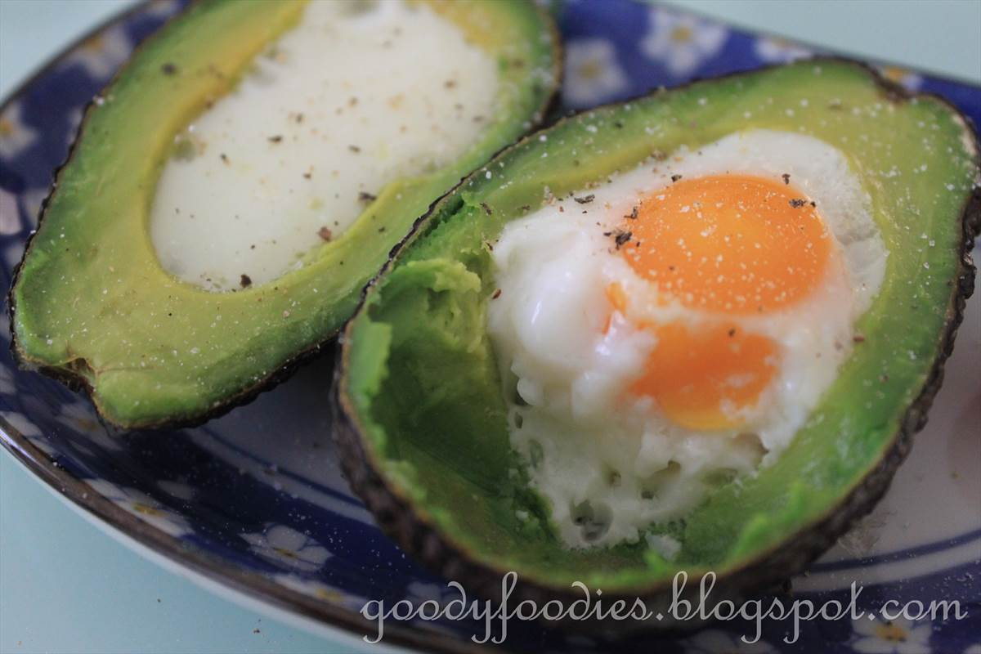
Macronutrients. Introduction to Carbohydrates, Proteins and Fats
Brian Darby
Advanced Diploma in Sports Nutrition

Slide 2
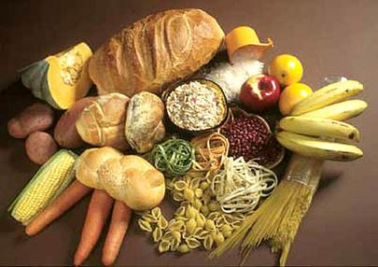
Carbohydrates. What are they?
Principal source of energy.
Most important fuel for exercise. Required in greater amounts for athletes.
Carbohydrates can be classified as “Simple” or “Complex”. Simple Carbohydrates will spike Blood Glucose Levels, Complex Carbohydrates will allow for a controlled and slow release of energy.
No “One Size fits all”.
Carbohydrates are burned under high intensity

Slide 3
Carbohydrates- Why we need them
Stored in the muscles as Glycogen which is converted to Glucose. This is our Fuel. More CHO’s needed on match and training days.
If an athlete runs out of Glucose, the body will burn Protein in its place.
This will lead to muscle breakdown, fatigue, poor performance and higher risk of injury.
Most athletes will “Carb Load” 3 Days before a big game. This combined with reduced training load will positively increase glycogen stores. Very important to use Smart Carbs only.

Slide 4
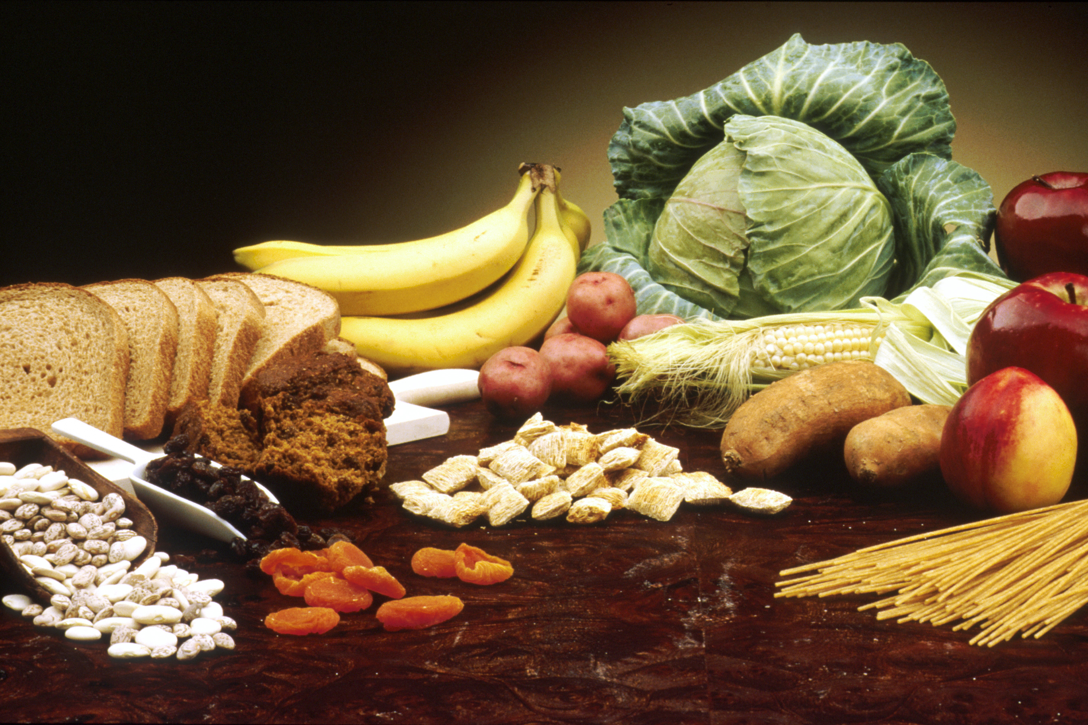
Carbohydrates- Sources
Simple Carbohydrates (High GI 70+)
Quick sugar rush
White bread, rice, pasta
Sweets and jellies
Soft drinks, Lucozade, Cordial
Biscuits
Complex Carbohydrates(Low GI 0-55)
Slow & Gradual release of energy
Whole-wheat Pasta
Brown Rice
Sweet Potato
Vegetables
Porridge

Slide 5
Huge variance depending on needs
Not “One Size Fits All”
Simple CHO’s needed after exercise to replenish glycogen stores in muscles
Soft Drinks, Diet Drinks and Sugar Free Drinks AVOID, AVOID AVOID
A trained athlete has twice as much stored glycogen as a sedentary person

Slide 6
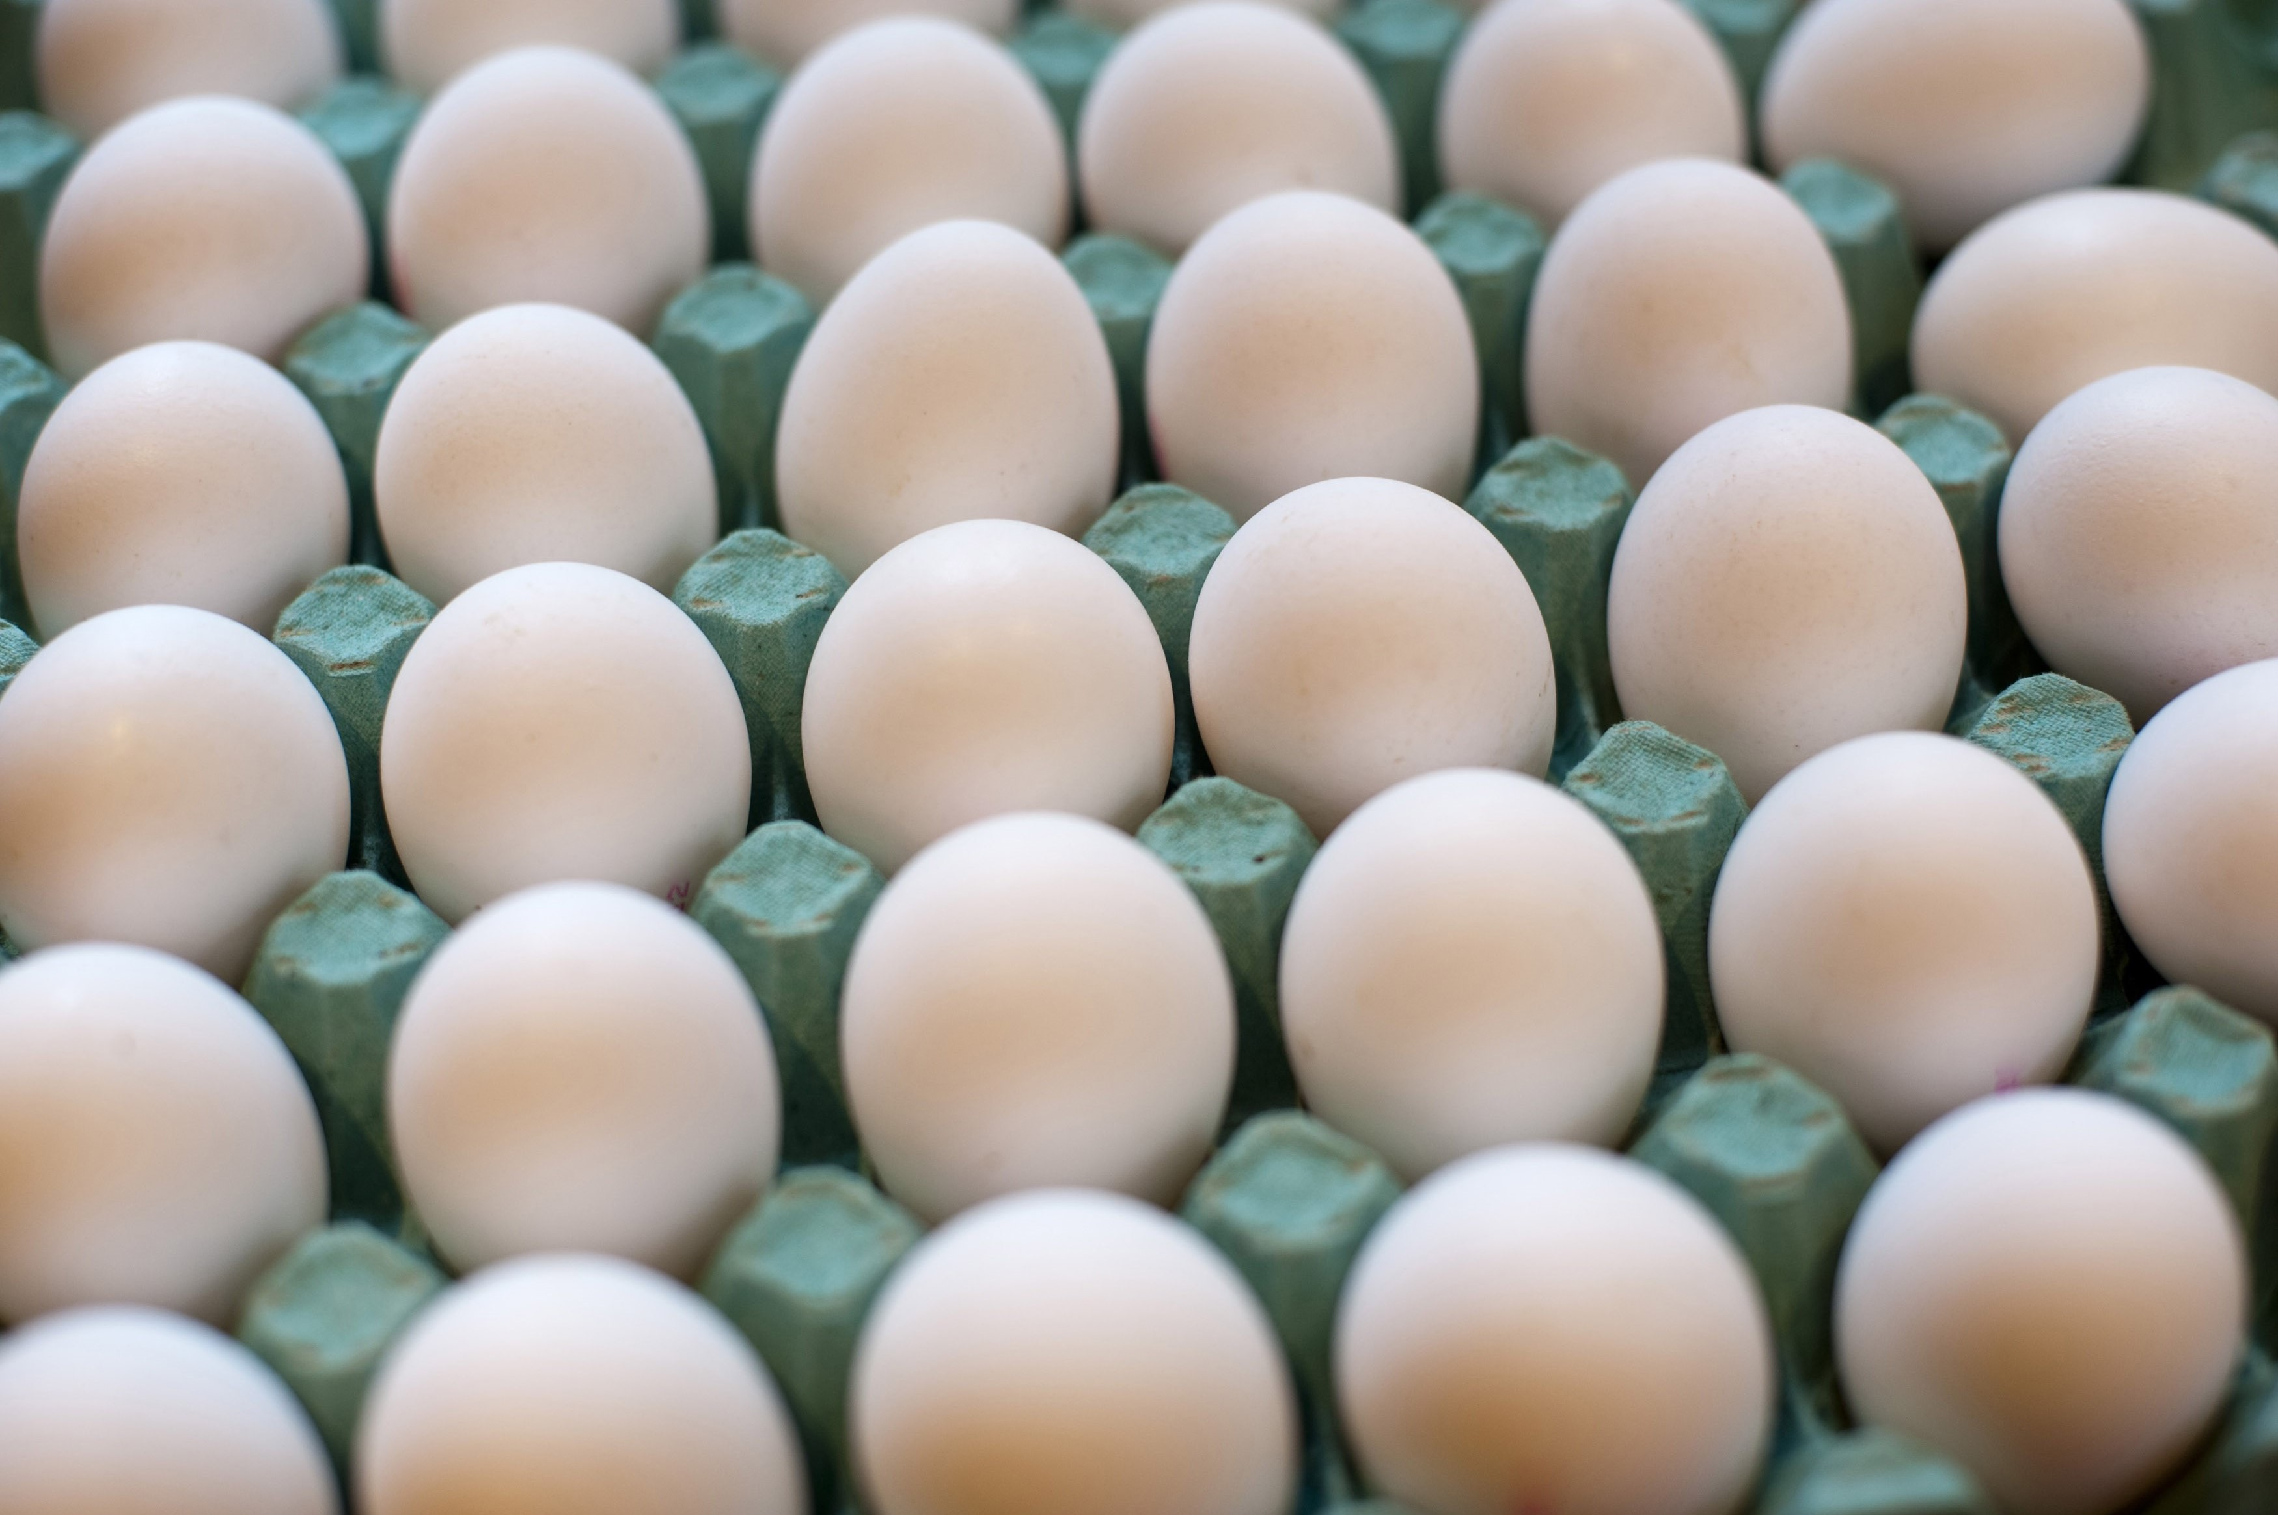
Proteins- What are they?
Proteins are Amino Acids.
Body’s ability to digest protein will depend on body weight and composition.
Amino Acids can be Essential (Can’t be produced by the body and must be taken in through food) and Non-Essential. (Got from Food Sources)
Building Blocks for Muscle. Nitrogen is key.

Slide 7
Proteins- Why we need them?
Primary function: Growth and repair of tissues and cells
Enzymatic function- all enzymes are proteins
Transport function- Act as carriers for other nutrients
Hormonal function- e.g. insulin
Immune function- antibodies fight illness
Buffering function- maintain pH balance of the blood

Slide 8
Protein Sources
High Biological Value
Low Biological Value

Slide 9
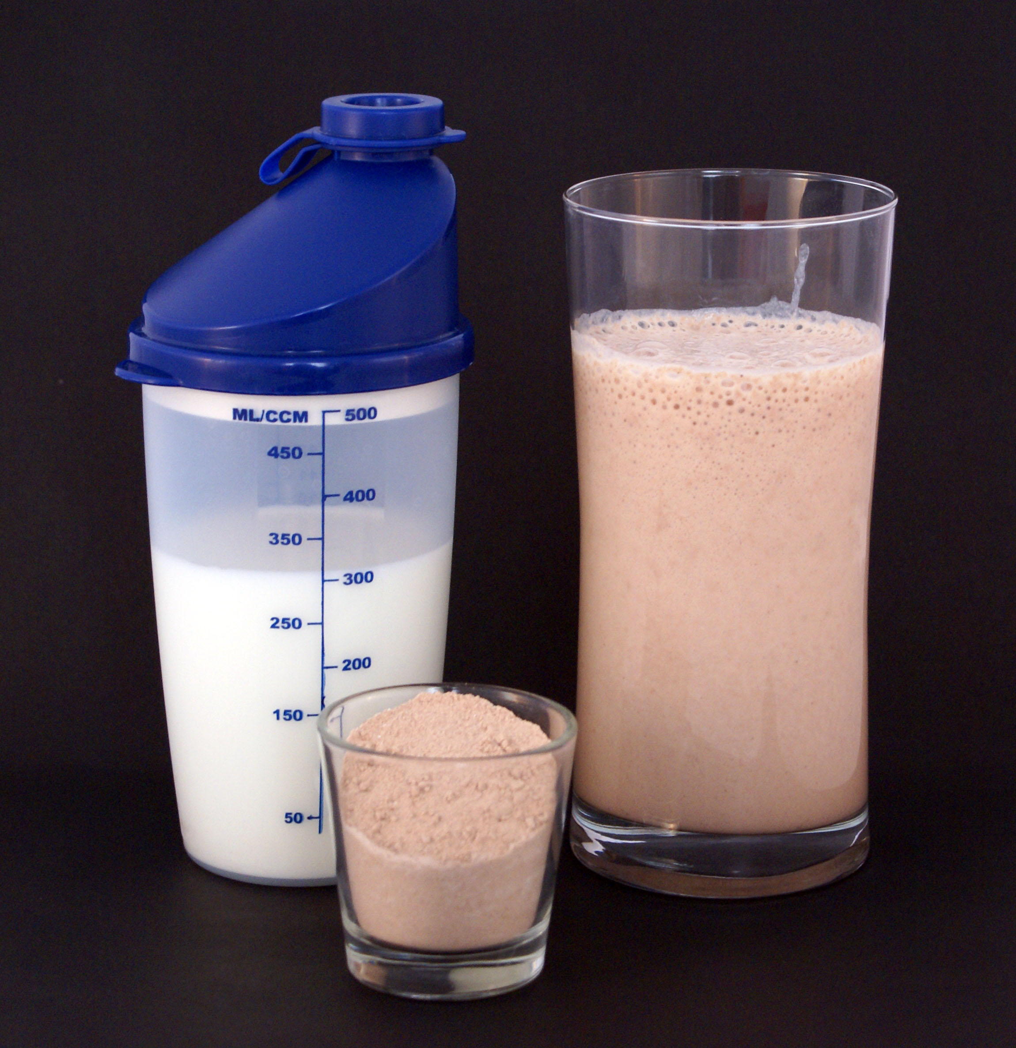
Protein- Recommended Daily Allowance
Guidelines for protein ingestion- 0.8g/kg/BW/day. Research recommends up to 2.5g/kg/bw/day for athletes. 2g/kg/BW/day recommended for GAA players
Ingestion needs to be properly spaced out over the
course of the day
Average person capable of ingesting
approximately 30g protein in each sitting

Slide 10
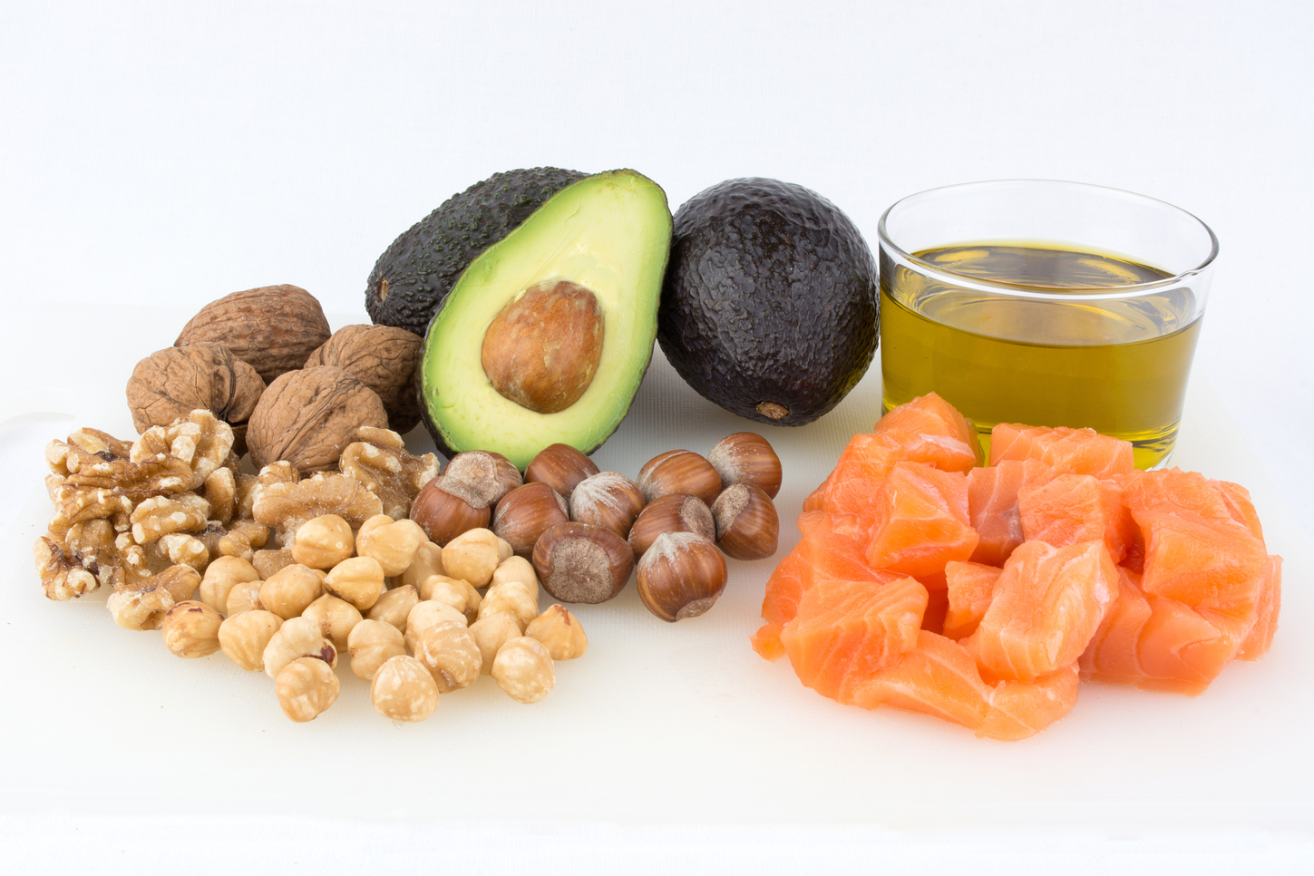
Fats- What are they
3 main types. Trans fats, Saturated fats and Unsaturated fats
Trans fats should be avoided.
Saturated fats (chicken, butter, cheese, beef) are animal sources. High Saturated Fat Diet can lead to heart attacks, strokes, obesity.
Unsaturated fats (Avocados, nuts, seeds, salmon) are plant sources.

Slide 11
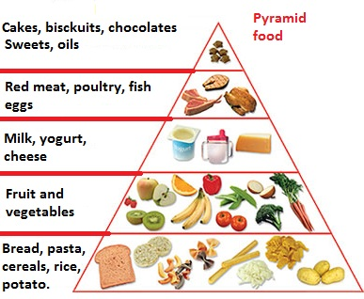
Fats- Why we need them?
We have been made to believe that fats are bad. Food pyramid states 2 servings/day. Dangerously inaccurate
Unsaturated Fats (HDL Cholesterol) travel through our blood and reduce, reuse and recycle LDL Cholesterol by sending it to our liver where it is reprocessed.
Fat is our bodies main resting fuel source. Burned at low intensity in the absence of carbohydrates.
Insulate, store our fat soluble vitamins and antioxidants, provide essential fatty acids, develop hormones and are energy dense.

Slide 12
Fats-Recommended Daily Allowance
Aim for a fat intake between 20 -35% of calories.
Saturated Fats should be eaten in moderation. Unsaturated Fats should form the majority of our fats. LDL v’s HDL’s
Excessively Low Body Fat % can lead to host of problems. Blood pressure, blood clotting, infertility in men and women, absence of EFA, Minerals and Fat Soluble Vitamins.

Slide 13
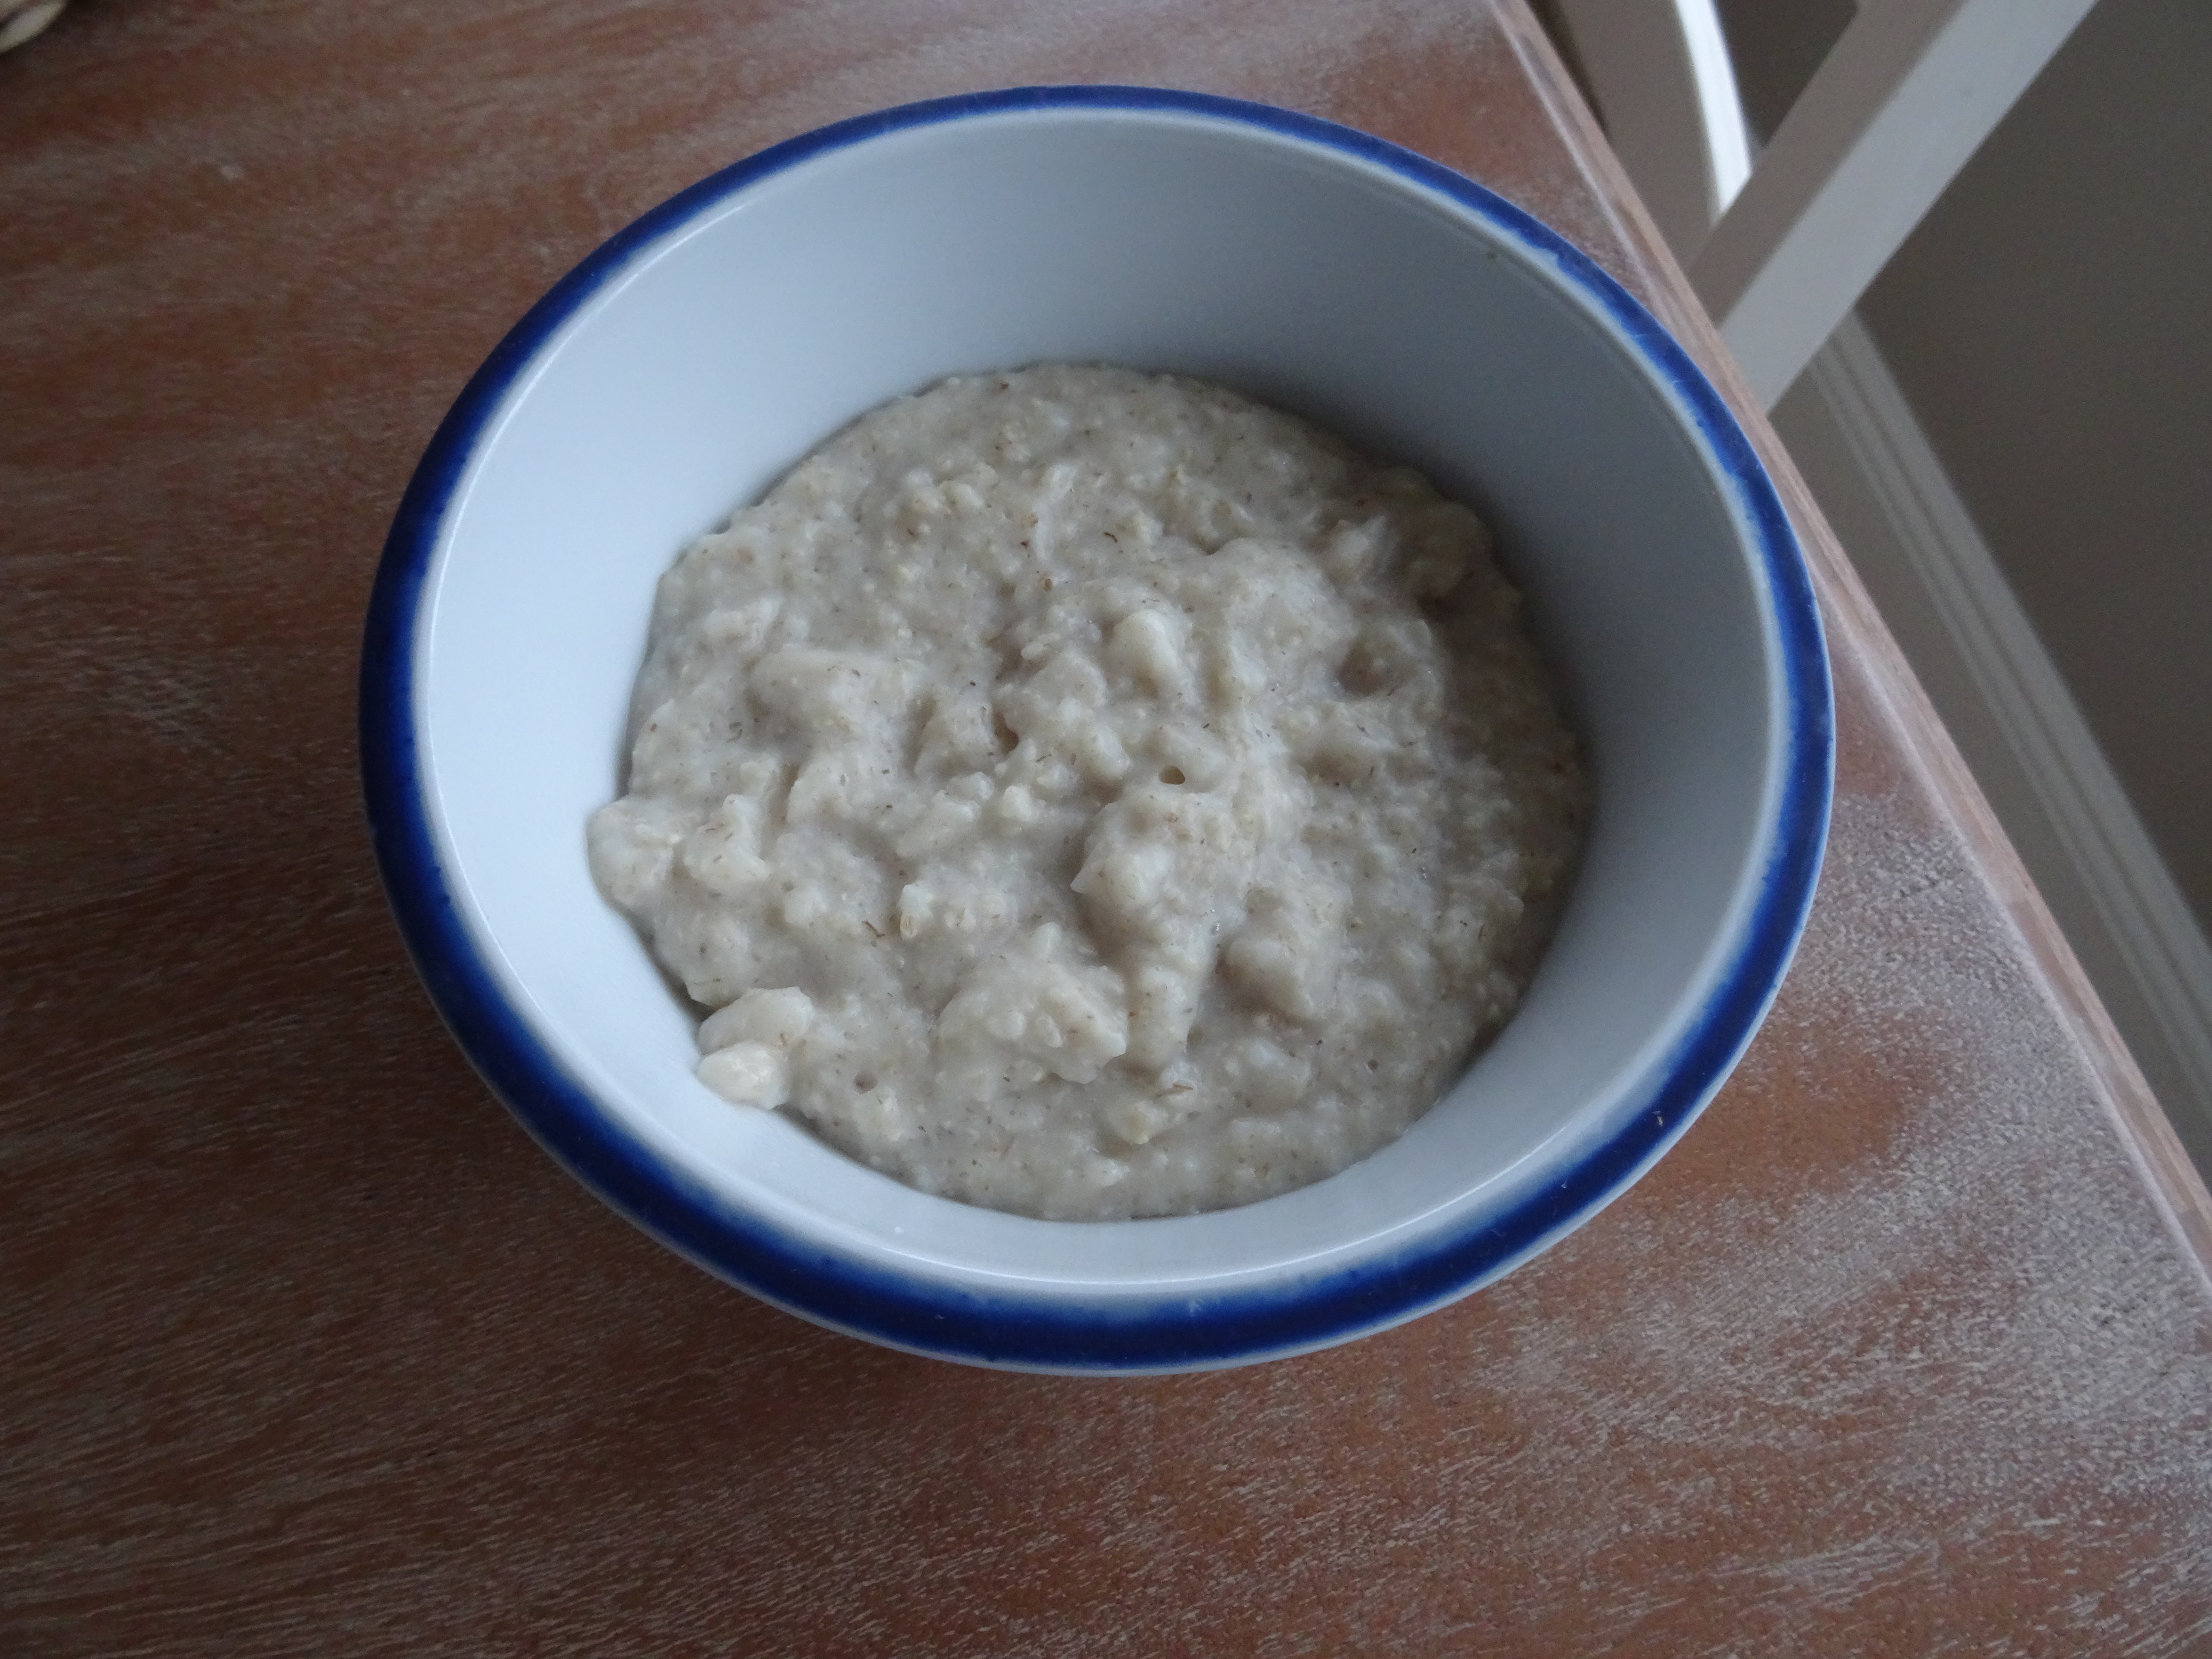
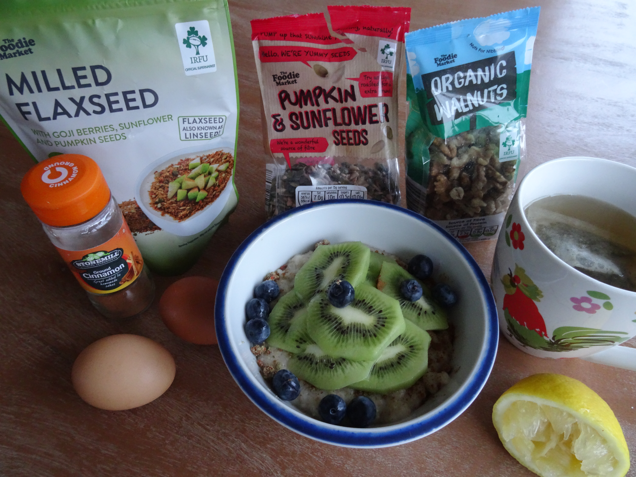
Sample Foods- Breakfast
All foods can be made better, all foods can be made worse.
All easily acquired ingredients. Slow release carbs, good fats, HBV and LBV protein sources, vitamins and minerals, antioxidants

Slide 14
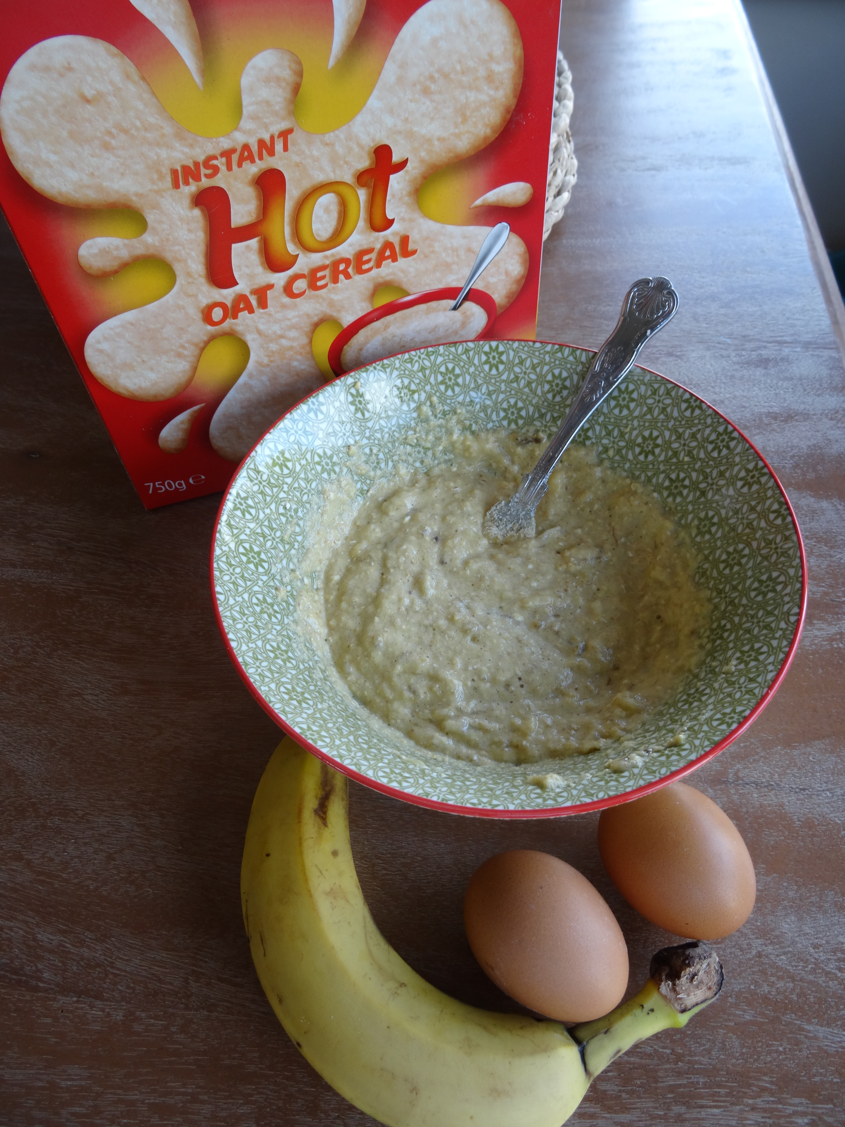
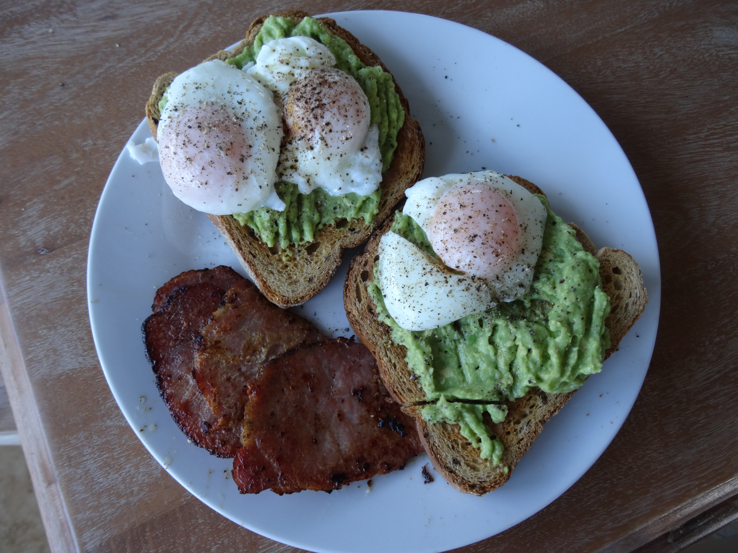
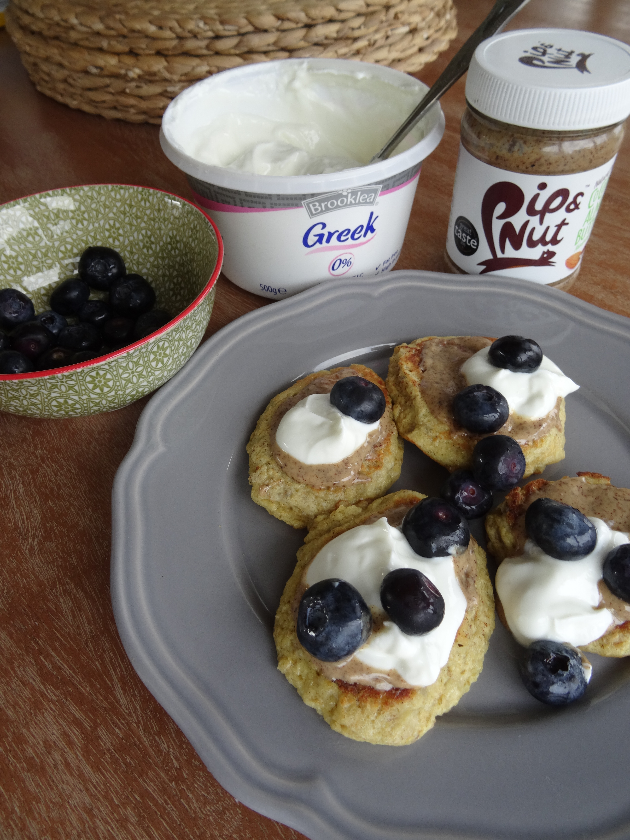
Healthy Snacks

Slide 15
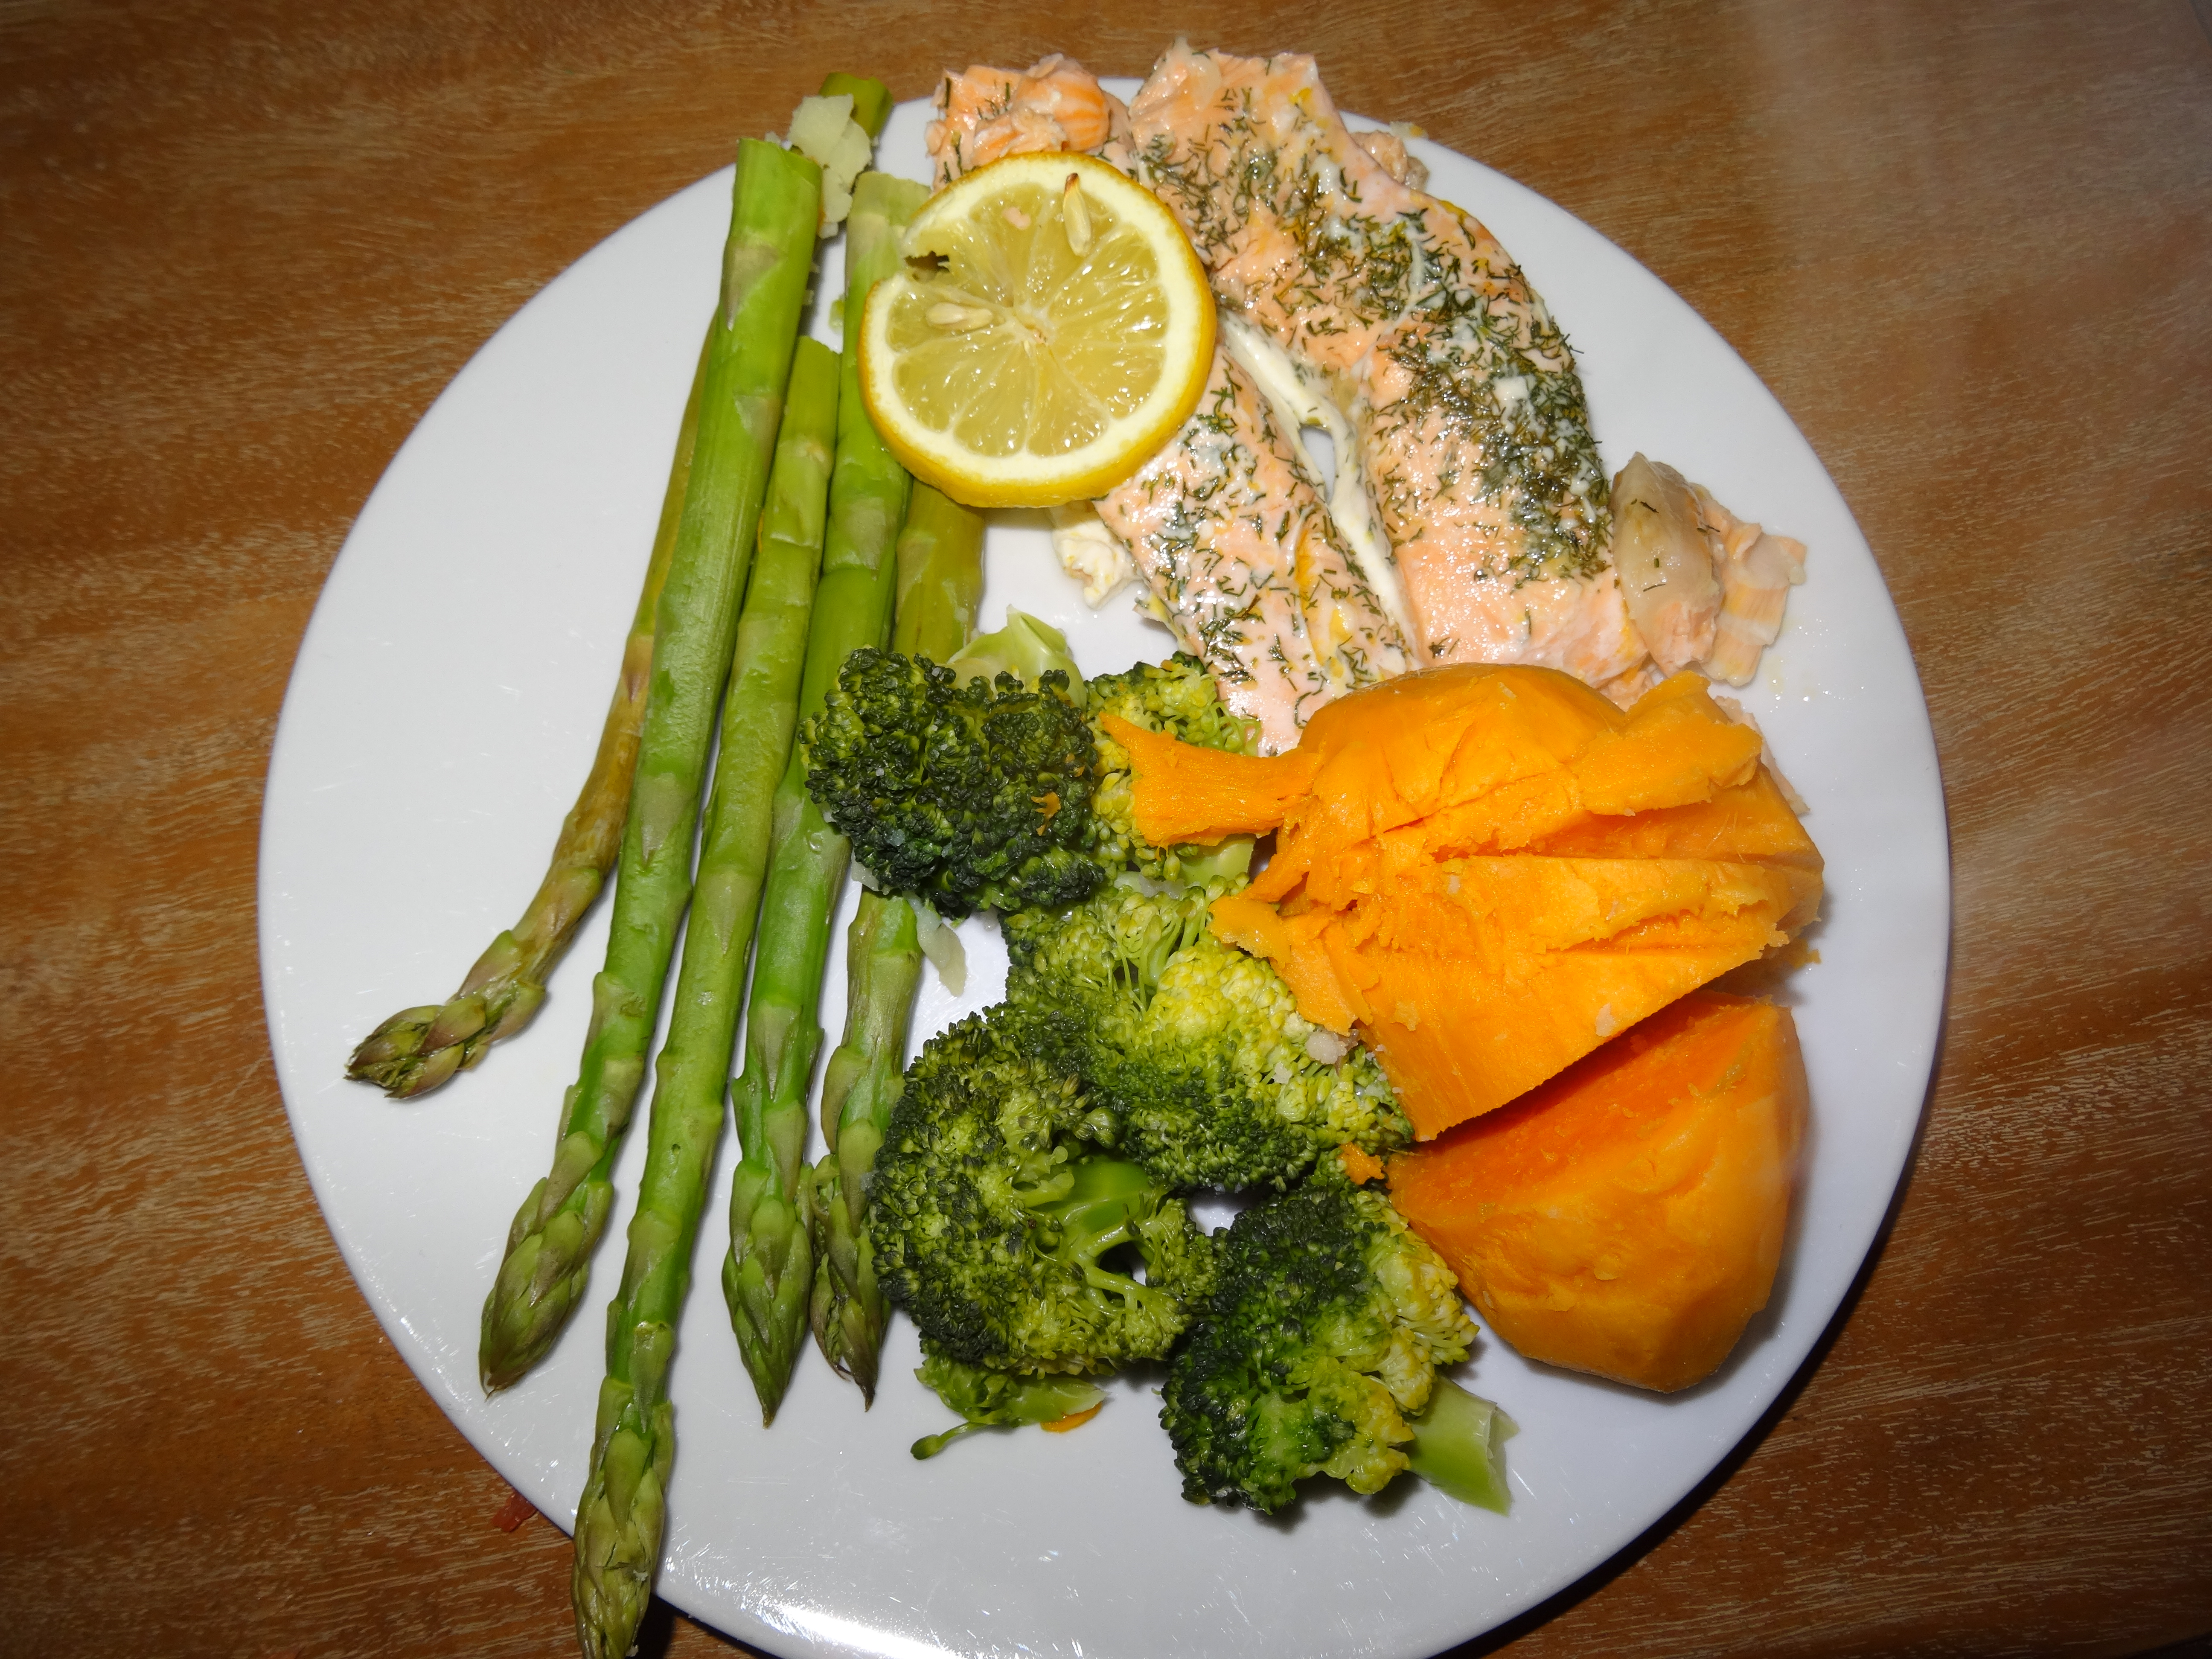
Lunch and Dinner

Slide 16
Weekly Meal Plan

Slide 17
Golden Rules
6 Meals/Day. 3 Main Meals, 3 Good Snacks
All Foods can be made better and can also be made worse
If it was eaten 100 years ago, it’s good enough today!
Form good habits which you can maintain. Remember no one size fits all.
2-3 litres of water/day. Avoid Soft Drinks, Diet Drinks and Sugar Free Drinks
Rule of thumb, consume more vegetables than fruit each day

Slide 18
Questions??? Many Thanks & Good Luck
@bodiarmada
Brian Darby
087 9164739

